Slide 1
Predictive Analysis of ECB Violations
Darius Mehri, Lior Shahverdi

Slide 2
Research Objective and Methods
Objective
Develop a predictive model for ECB violations.
(i.e. if one type of ECB violation is found, what other types of violations are likely to be found at the same location)
Methods
Market basket (aka Association Rules Modeling) and social network analysis.
Data
5 years of ECB violations (2010-2015).

Slide 3
Market Basket Analysis
The objective of market basket analysis is to determine which items are likely to appear in any given transaction.
A transaction is composed of a group of one or more items (an itemset).
The result of a market basket analysis is a list of association rules that show patterns found in the relationships among items in an itemset.

Slide 4
Association rules are denoted by relating one itemset on the left-hand side of the rule to another itemset on the right-hand side of the rule.
Example: {peanut butter, jelly} -> {bread}
For the ECB violation analysis, a transaction is an itemset of violation infraction codes for a single building:
BIN 2065945 includes 101, 103, 110
BIN 1000038 includes 22, 770, 80, 64, 110

Slide 5
Results
The analysis produced over 200 association rules.
Most interesting:
Rule 1:
155: FAIL MAINTAIN BLDG IN COMPLIANT MANNER:LACK OF AUTOMATIC SPRINKLERS
189: FAIL TO MAIMTAIN REQUIRED NUMBER OF MEANS OF EGRESS FOR EVERY FLOOR
=>106k:ILLEGAL ACTIVITY
Rule 2:
105: 1 OR 2 FAMILY CONVERTED/MAINTAINED AS DWELLING FOR 4 OR MORE FAMILIES
187: UNLAWFUL ACTS.FAILURE TO COMPLY WITH AN ORDER OF THE COMMISSIONER
=>101: WORK WITHOUT A PERMIT

Slide 6
Social Network Analysis
Social network analysis is the process of investigating social structures.
Network structures are defined in terms of nodes (individual actors) and the ties or edges (relationships or interactions) that connect them.

Slide 7
Goal of SNA
Visualize the strength of ties among the violations.
Violations with strong ties are more likely to occur together, meaning that if one type of violation is issued, then another type of violation is likely to be immediately issued as well.
Explore the clustering of violations.
A high clustering means a specific group of types of violations are similar to each other in the network.

Slide 8
Data
We created an undirected set of ties for each BIN’s group of infraction codes. For example, if BIN 3216549 had infraction codes 101, 103, and 110, then its set of ties would be:
101 and 103
101 and 110
103 and 110

Slide 9
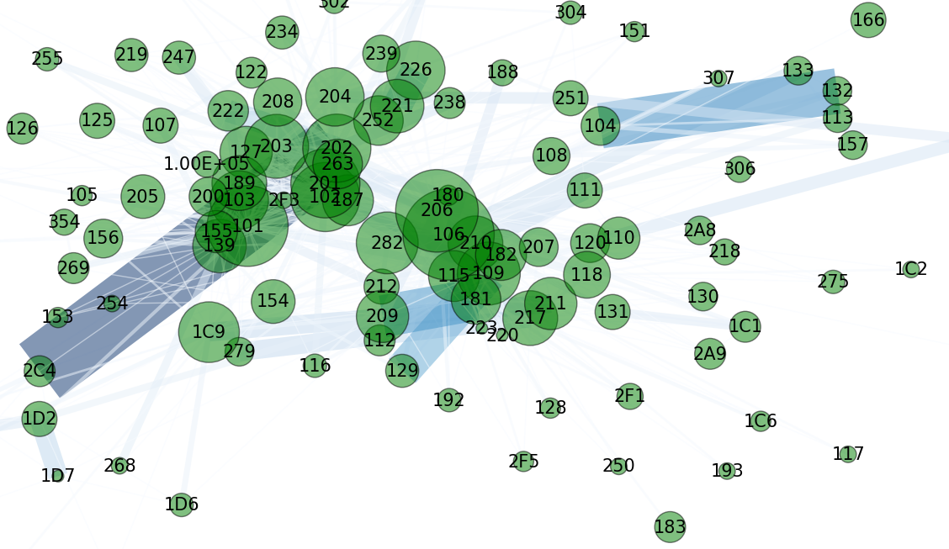
January 2015

Slide 10
January 2015

Slide 11
January 2015

Slide 12
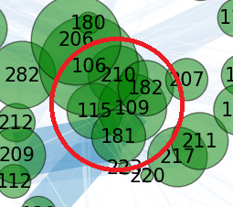
January 2015 Building Safety Cluster
Cluster composed of: 210: Failure to Provide Documents at Construction Site, 115: Failure to Maintain Safety Equipment, 182: Work Not Conforming to Documents, 109: Failure to Safeguard Persons and 181: Failure to Maintain Housekeeping.

Slide 13
Conclusion
Two analytic research methods:
Inductive, bottom-up.
Deductive, top-down.
Researchers found it difficult to implement inductive method – lack of domain knowledge makes it difficult to interpret results.
Propose top-down, deductive method:
Work with ECB specialist(s) with domain knowledge to formulate research question.
Narrow scope of research.
Validate findings.

